Slide 1

Book Bank System
Proposed By:
HARISH.A 820617104017
BALAMURUGAN.P 820617104008

Slide 2
Abstract
The Book Bank system is a user-friendly android application for library to manage the book issuing process and to take proper maintenance of the books. The Students can retrieve information about the available books and can search the books they want.
This designed for mainly two types of users. They are Students and Librarian. It lends books to member, who is registered in the system. Also, it handles the purchase of new titles for the Book Bank. Popular titles are brought into multiple copies. Old books and magazines are removed when they are out or date or poor in condition. A member can reserve a book or magazine that is not currently available in the book bank, so that when it is returned or purchased by the book bank, that person is notified. The Librarian can easily add details about the books.

Slide 3
Purpose:
To reduce the time taken for the Books to reach the student.
Problem Addressed:
If the entire process of 'Issue of Books or Magazines' is done in a manual manner then it would take several months for the books or magazines to reach the applicant. Considering the fact that the number of students for Book Bank is increasing every year, an Automated System becomes essential to meet the demand.
Objective:
The main objective includes
Reduce time consumption.
Reduce man power.
Workload will be reduced.
Existing system:
The existing system works by mostly manual and the work load will increase drastically on normal condition. There is no synchronization between the processes when using the normal manual system.

Slide 4




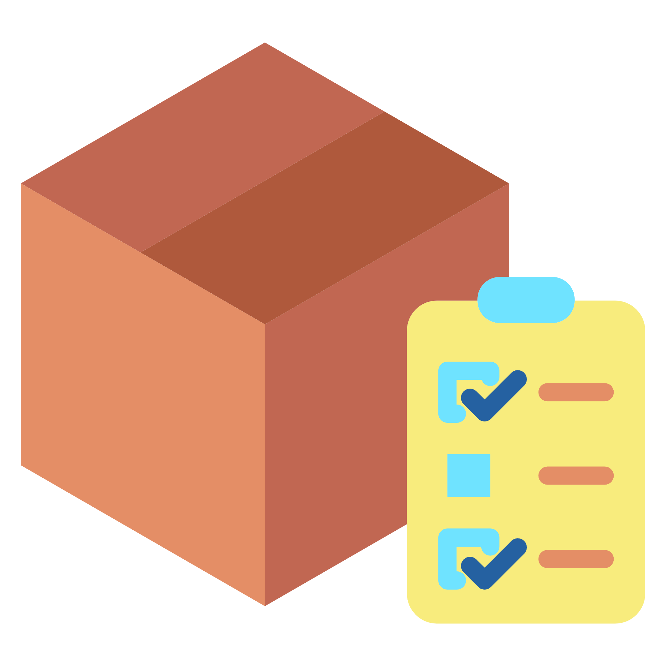
Proposal System
SEARCH FOR BOOKS
REQUEST PENDING
ISSUED
The students search for the book
via the application
The request will be on queue
After arrival of books , it will be
issued
REQUEST
ORDERED
When the book is not available , request for the book is placed.
The orders will be placed for the books

Slide 5
ADVANTAGES
Books can be searched at anywhere at anytime.
Collection of books will be maintained properly.
No need for PC or Laptop , can be done at mobile devices.
List of books can be viewed without going to the library.
Time will be saved drastically.
Request for books can be placed by the students easily.
Work load for the librarian will be reduced.
Everything will work on schedule.
LIMITATIONS
You need mobile phone with android version 5.1 or higher.
May require internet connection for synchronization of data.

Slide 6

PLATFORM
About
Android is a mobile operating system based on a modified version of the Linux kernel and other open source software, designed primarily for touchscreen mobile devices such as smartphones and tablets. Android is developed by a consortium of developers known as the Open Handset Alliance, with the main contributor and commercial marketer being Google.
Why we chose android?
Due to the popularity of android and the vast usage of mobile devices among people (students).So, it will reach easily than other platforms like Windows.

Slide 7
MODULES DESCRIPTION
BookDatabase – Contains the functions that are required for creating an database for books and to show them as a list in recyclerview.
DashboardActivity – Holds the codes for logout and to display an welcome message when the user Logins.
HomeActivity – Contains the codes to access the RecyclerView , Search bar, and List view.
LibrarianEntry – Helps to create an database for storing the book details such as author and book name.
LibrarianLogin – For authentication of the librarian.

Slide 8
MainActivity – Providing Login services and Signup options this uses the SQLiteHelper class for storing details of the students.
RegisterActivity – To provide the Signup function.
RequestActivity – Allows user to request the book they want.
SQLiteHelper – Creates Database using the SQLite Libraries for storing information about the student credentials.

Slide 9
USE CASE DIAGRAM
Book issue
Book return
Student
Librarian
Book entry
Search book details
Vendor
Book order

Slide 10
Activity Diagram
Request for specific book
Available?
No
Enquires for alternative book
Yes
Borrows book
Is satisfied?
Yes
No
Transaction done
Transaction cancelled

Slide 11
COLLABORATION DIAGRAM
1:request
7:another book request
13:provide details
14:enter issue data
:issue
Student
6:not available
12:available
18:issue book
24:book return
17:update
librarian
2:check available book
8:check availability
15:update issue status
16:issue status update
5:not available
11:available
DB
23:update
20:book details
21:update
3:available book
9:check available
4:not available
10:available
22:status upload
search
:return

Slide 12
SEQUENCE DIAGRAM
Student
librarian
issue
returns
search
DB
1:request book
3:check available book
2:check available book
6:not available
5:not available
4:not available
7:request for another book
8:check availability
9:check availability
12:available
11:available
10:available
13:provide student details
14:issue
15:update
18:issue book
17:update
16:issue update
19:request to return
20:enter book details
21:return status

Slide 13
SCOPE OF THE PROJECT
The System provides an interface to the user where they can fill in their personal details and submit the necessary documents (may be by scanning). The authority concerned with the issue of books can use this system to reduce his workload and process the application in a speedy manner.
Timed delivery of books can be achieved through this application.

Slide 14



SOFTWARE REQUIREMENT
FRONT END:
Java - v8u241 for making the application functioning as we want .
XML for designing the layout in android studio
BACK END:
Sqlite - v3.31.1 most widely used database in android.
IDE & TOOLS:
Android Studio -v3.6 made by INTELLIJ , this is the powerful , Up to- date software used by developers to create native high performance app for android

Slide 15
Thank you

